Slide 1
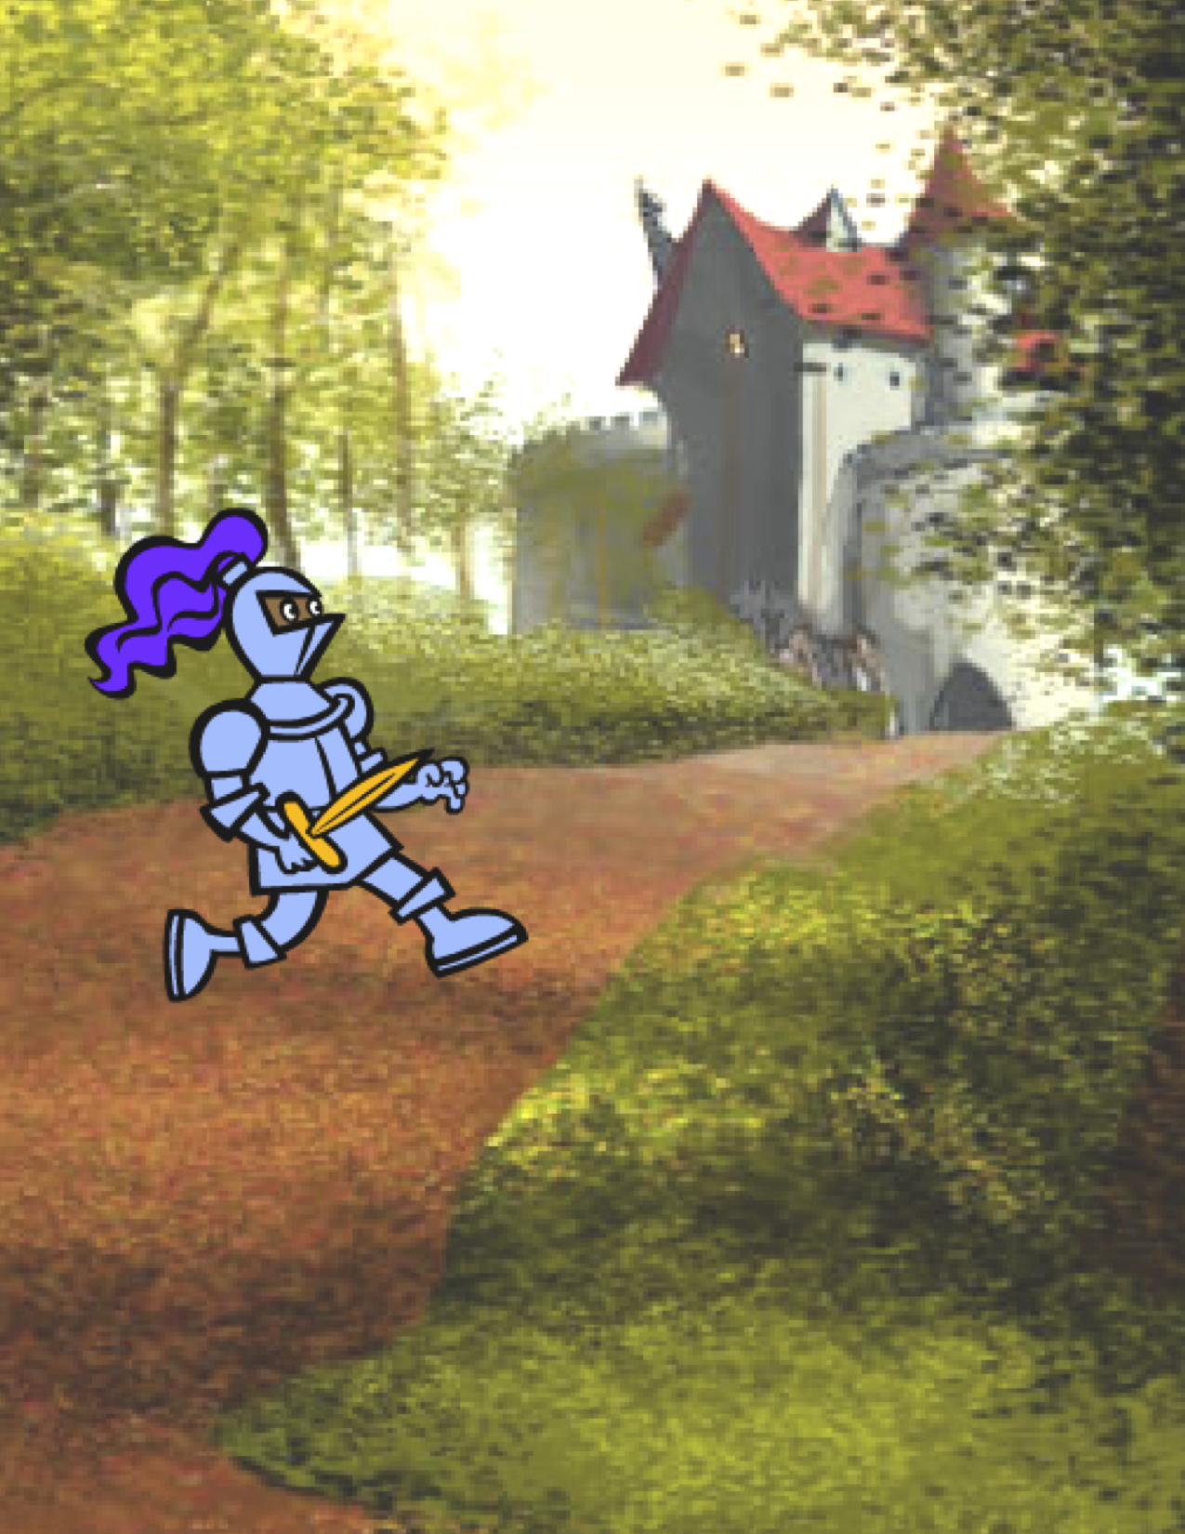
UNIT 3
STORIES
WHAT’S INCLUDED
YOU ARE HERE
CHARACTERS 58
CONVERSATIONS 60
SCENES 62
DEBUG IT! 64
CREATURE CONSTRUCTION 66
PASS IT ON 68
0
1
2
3
4
5
6
55
55
Notes:
<numéro>

Slide 2
UNIT 3
OVERVIEW
THE “BIG IDEA”
THE “BIG IDEA”
In the introduction to his doctoral dissertation exploring remix culture, Andres Monroy-Hernandez (the lead designer of the initial version of the Scratch online community) included three quotes:
Building on other people’s work has been a longstanding practice in programming, and has only been amplified by network technologies that provide access to a wide range of other people’s work. An important goal of creative computing is to support connections between learners through reusing and remixing. The Scratch authoring environment and online community can support young designers in this key computational practice by helping them find ideas and code to build upon, enabling them to create more complex projects than they could have created on their own.
The activities in this unit offer initial ideas and strategies for cultivating a culture that supports reusing and remixing. How can you further support sharing and connecting?
We are like dwarfs standing upon the shoulders of giants, and so able to see more and see farther than the ancients.
– Bernard of Chartres, circa 1130
If I have seen further it is by standing on the shoulders of giants.
– Isaac Newton, 1676
A dwarf on a giant’s shoulders sees farther of the two.
– George Herbert, 1651
LEARNING OBJECTIVES
KEY WORDS, CONCEPTS, & PRACTICES
Students will:
gain familiarity in and build understandings of the benefits of reusing and remixing while designing
develop greater fluency with computational concepts (events and parallelism) and practices (experimenting and iterating, testing and debugging, reusing and remixing)
explore computational creation within the genre of stories by designing collaborative narratives
reusing and remixing
make a block
backpack
stage
pass-it-on story
pair programming
scratch screening
design demo
NOTES
Reusing and remixing support the development of critical code-reading capacities and provoke important questions about ownership and authorship. Consider different strategies for how you might facilitate, discuss, and assess cooperative and collaborative work.
56
Notes:
<numéro>

Slide 3
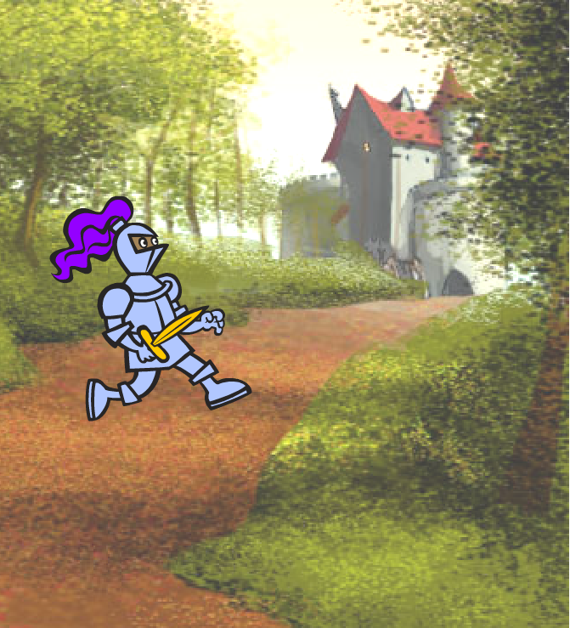
CHOOSE YOUR OWN ADVENTURE
This unit focuses on helping students develop their storytelling and remixing abilities through a variety of hands-on and off-computer design activities, providing opportunities for students to work collaboratively and build on the creative work of others. Building on initial experiences from Unit 2, the activities in this unit are designed to help students develop deeper fluency in the computational concepts of events and parallelism and the computational practices of experimenting and iterating and reusing and remixing. Each capacity-building activity is designed to help students build up storytelling projects by discovering new blocks and methods for programming interactions between sprites and backdrops, culminating in a Pass It On project.
POSSIBLE PATH
SESSION 1
SESSION 2
SESSION 3
SESSION 4
SESSION 5
CHARACTERS
CONVERSATIONS
SCENES
DEBUG IT!
CREATURE CONSTRUCTION
PASS IT ON
Create your own Scratch blocks using Make a Block.
How do you coordinate interactions between sprites using timing and broadcasting?
What's the difference between the Stage and sprites?
Help!
Can you debug these five Scratch programs?
What can we create by building on others’ work?
What can we create by building on others’ work?
57

Slide 4


CHARACTERS
OBJECTIVES
By completing this activity, students will:
experiment with defining behaviors for characters using Scratch’s Make a Block feature
gain more familiarity with the computational concepts of events and parallelism and the practice of experimenting and iterating
UNIT 3 ACTIVITY
_{SUGGESTED TIME}
30–45 MINUTES
ACTIVITY DESCRIPTION
RESOURCES
Optionally, show example projects from the Characters studio and have the Characters handout available to guide students.
Give students time to create their own Scratch blocks using the Make a Block feature found in the More Blocks category. Help them design two sprites or “characters” that each have two behaviors. Optionally, conduct a walkthrough of the Make a Block feature together as a class.
Allow students to share their characters and behaviors with one another. We suggest the design demo activity: invite a few students to present their work to the class and demonstrate how they implemented the Make a Block feature. Optionally, have students add their projects to the Characters studio or a separate class studio.
Ask students to think back on the design process by responding to the reflection prompts in their design journals or in a group discussion.
Characters handout
Characters studio http://scratch.mit.edu/studios/475545
REFLECTION PROMPTS
How would you explain Make a Block to someone else?
When might you use Make a Block?
REVIEWING STUDENT WORK
Do projects include two sprites that each have two behaviors using the Make a Block feature?
Can students explain how to use the Make a Block feature to each other and to you?
NOTES
NOTES TO SELF
If students are struggling with figuring out how to use the Make a Block feature, invite them to explore how others implemented the feature by investigating the code of projects in the Characters studio.
Learn more about the Make a Block feature in this video tutorial: http://bit.ly/makeablock
58
Notes:
<numéro>

Slide 5
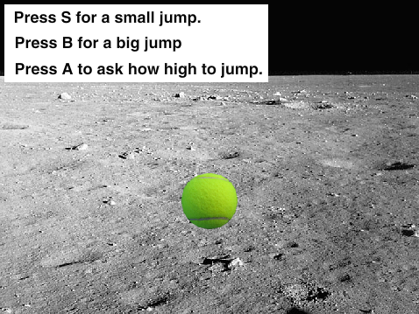
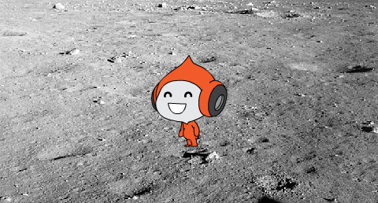
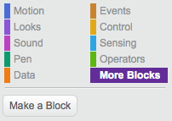
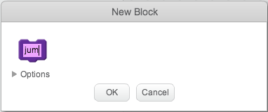
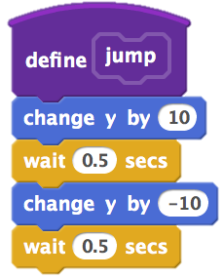
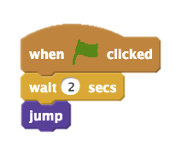
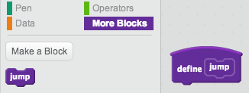
CHARACTERS
DO YOU WANT TO CREATE YOUR OWN SCRATCH BLOCKS?
Experiment with the Make a Block feature in Scratch! In this project, you will create your own blocks that define two behaviors for two different characters.
START HERE
Choose from the library, paint, or upload two sprite characters.
Click on the Make a Block button in the More Blocks category to create and name your block.
Add blocks under the Define block to control what your custom block will do.
Experiment with using your block to program your characters’ behaviors.
Repeat!
THINGS TO TRY
FINISHED?
Feeling stuck? That’s okay! Check out this video to get started with the Make a Block feature: http://bit.ly/makeablock
Explore other projects in the Characters Studio to see what new blocks others have created.
Sometimes there can be more than one way of defining the same behavior. Experiment with different block combinations to try out multiple options and outcomes.
Add your project to the Characters Studio: http://scratch.mit.edu/studios/475545
Challenge yourself to do more! Experiment with adding different characters and behaviors using the Make a Block feature.
Help a neighbor!
Notes:
<numéro>

Slide 6
CONVERSATIONS
OBJECTIVES
By completing this activity, students will:
explore two different strategies for synchronizing interactions between sprites (timing and broadcasting) by remixing a joke project
develop greater familiarity with the computational concept of events and parallelism and the practice of reusing and remixing
UNIT 3 ACTIVITY
_{SUGGESTED TIME}
30–45 MINUTES
ACTIVITY DESCRIPTION
RESOURCES
Optionally, explore the Penguin Joke starter project as a group and have the Conversations handout available to guide students.
Invite students to see inside the Penguin Joke starter project to observe how the conversation is animated using wait blocks. Have students use the remix function and redesign the Penguin Joke project to coordinate the conversation using the broadcast, broadcast and wait, and when I receive blocks.
Encourage students to share their joke projects with one another. We suggest the design demo activity: invite a few students to present their work to the class and demonstrate how they implemented broadcast. Optionally, have students add their projects to the Conversations studio or a class studio.
Ask students to think back on the design process by responding to the reflection prompts in their design journals or in a group discussion.
Conversations handout
Penguin Joke starter project http://scratch.mit.edu/projects/10015800
Conversations studio http://scratch.mit.edu/studios/475547
REFLECTION PROMPTS
How would you describe broadcast to someone else?
When would you use timing in a project? When would you use broadcasting?
REVIEWING STUDENT WORK
Do projects use the broadcast and when I receive blocks?
Can students explain how to use the broadcast, broadcast and wait, and when I receive blocks?
NOTES
NOTES TO SELF
If students are having trouble understanding how to use the broadcast and when I receive block pair, invite them to explore the code of example projects in the Broadcast Examples studio: http://scratch.mit.edu/studios/202853
60
Notes:
<numéro>

Slide 7
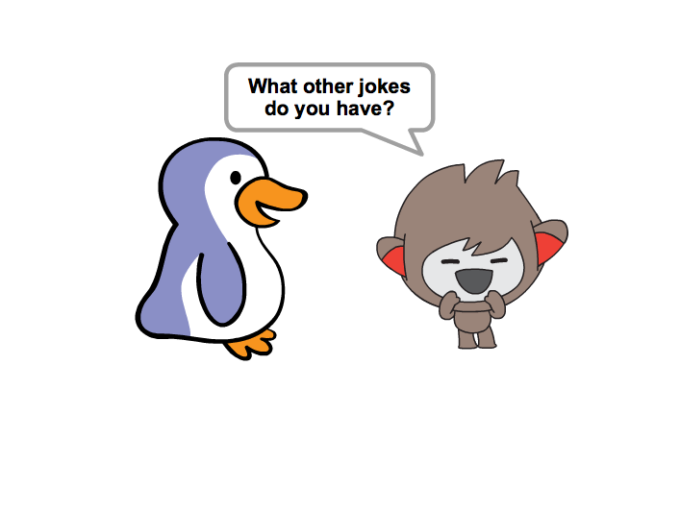
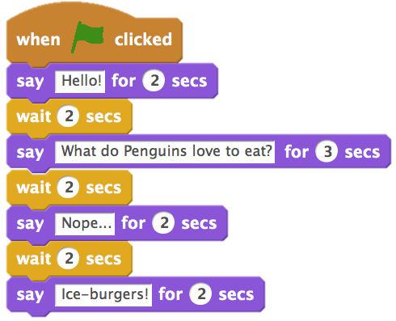
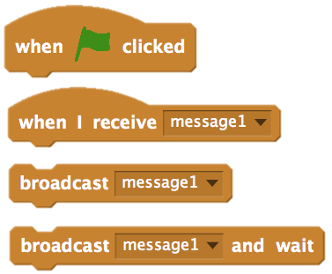
CONVERSATIONS
WHAT ARE DIFFERENT WAYS TO COORDINATE INTERACTIONS BETWEEN SPRITES?
In this activity, you'll explore different ways to program sprites to have conversations! Experiment with timing and explore using broadcast by remixing a joke project.
START HERE
Look inside the Penguin Jokes project: http://scratch.mit.edu/projects/10015800
Investigate the code to see how the wait and say blocks are used to coordinate the conversation.
Remix the project to use the broadcast and when I receive blocks instead of wait blocks.
FEELING STUCK?
_{THAT’S OKAY! TRY THESE THINGS…}
FINISHED?
Brainstorm ideas with a neighbor! Generate a list of possible solutions and test them out together.
Try using the broadcast and when I receive blocks in different parts of your project.
Explore projects in the Conversations studio to get inspiration for different ways to coordinate conversations between sprites.
Add your project to the Conversations studio: http://scratch.mit.edu/studios/475547
Challenge yourself to do more! Add other characters and conversations.
Share your project with a neighbor and walk them through your process of exploration and design.
Help a neighbor!
Notes:
<numéro>

Slide 8
SCENES
OBJECTIVES
By completing this activity, students will:
be able to create a project that experiments with changing backdrops, like a story with multiple scenes or a slideshow
gain more familiarity with the computational concepts of events and parallelism and the practice of experimenting and iterating
UNIT 3 ACTIVITY
_{SUGGESTED TIME}
30–45 MINUTES
ACTIVITY DESCRIPTION
RESOURCES
Optionally, show example projects from the Scenes studio and have the Scenes handout available to guide students.
Give students time to develop a project that includes multiple scene changes using different backdrops, such as in a slideshow. Challenge students to explore and manipulate scripts in the Stage to initiate backdrop changes.
Allow students to share their projects with one another. We suggest the design demo activity: invite a few students to present their work to the class and demonstrate how they implemented switching backdrops. Optionally, have students add their projects to the Scenes studio or a class studio.
Ask students to think back on the design process by responding to the reflection prompts in their design journals or in a group discussion.
Scenes handout
Scenes studio http://scratch.mit.edu/studios/475550
REFLECTION PROMPTS
What does the Stage have in common with sprites?
How is the Stage different from sprites?
How do you initiate a sprite’s actions in a scene?
What other types of projects (beyond animations) use scene changes?
REVIEWING STUDENT WORK
Do projects successfully coordinate multiple scenes using changing backdrops?
NOTES
NOTES TO SELF
If students are having trouble figuring out how to switch backdrops, encourage them to tinker with blocks under the Looks category, especially the switch backdrop to, switch backdrop to and wait, and next backdrop blocks.
62
Notes:
<numéro>

Slide 9
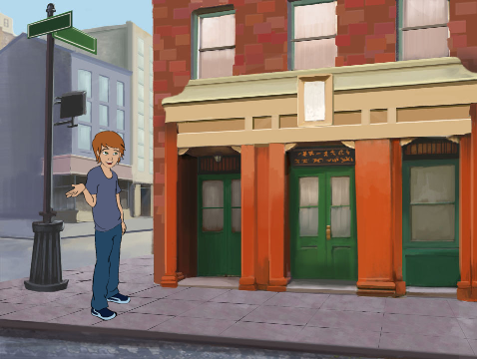
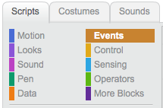
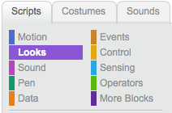
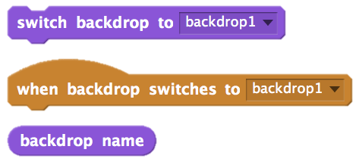
SCENES
WHAT IS THE DIFFERENCE BETWEEN THE STAGE AND SPRITES?
In this activity, you will create a project that experiments with backdrops, like a story with multiple scenes or a slideshow.
START HERE
Choose from the library, paint, or upload multiple backdrops into your project.
Experiment with blocks from the Looks and Events categories to initiate switching backdrops.
Add scripts to the stage and sprites to coordinate what happens when the backdrop changes in your project!
THINGS TO TRY
FINISHED?
Look for blocks under the sprites and the stage related to backdrop and test them out to see what they do!
Need more inspiration? Explore the Scratch online community to discover projects that use multiple backdrops.
Add your project to the Scenes Studio: http://scratch.mit.edu/studios/475550
Challenge yourself to do more! Add more backdrop changes to your project.
Help a neighbor!
Return to one of your previous projects or find a project you are inspired by and remix it by adding switching backdrops.
Notes:
<numéro>

Slide 10

DEBUG IT!
OBJECTIVES
By completing this activity, students will:
investigate the problem and find a solution to five debugging challenges
explore a range of concepts (including events and parallelism) through the practices of testing and debugging
UNIT3 ACTIVITY
UNIT 3 ACTIVITY
_{SUGGESTED TIME}
15–30 MINUTES
ACTIVITY DESCRIPTION
ACTIVITY DESCRIPTION
RESOURCES
Optionally, have the Unit 3 Debug It! handout available to guide students during the activity.
Help students open the Debug It! programs from the Unit 3 Debug It! studio or by following the project links listed on the Unit 3 Debug It! handout. Encourage students to click on the “Look Inside” button to investigate the buggy program, tinker with problematic code, and test possible solutions.
Give students time to test and debug each Debug It! challenge. Optionally, have students use the remix function in Scratch to fix the bugs and save corrected programs.
Ask students to reflect back on their testing and debugging experiences by responding to the reflection prompts in their design journals or in a group discussion.
Create a class list of debugging strategies by collecting students’ problem finding and problem solving approaches.
Unit 3 Debug It! handout
Unit 3 Debug It! studio http://scratch.mit.edu/studios/475554
REFLECTION PROMPTS
What was the problem?
How did you identify the problem?
How did you fix the problem?
Did others have alternative approaches to fixing the problem?
REVIEWING STUDENT WORK
Were students able to solve all five bugs? If not, how might you clarify the concepts expressed in the unsolved programs?
What different testing and debugging strategies did students employ?
NOTES
NOTES TO SELF
Being able to read others’ code is a valuable skill and is critical for being able to engage in the practices of reusing and remixing.
This activity is a great opportunity for pair programming. Divide students into pairs to work on the debugging challenges.
Students can explain their code revisions by right-clicking on Scratch blocks to insert code comments.
64
Notes:
<numéro>

Slide 11
DEBUG IT!
DEBUG IT! 3.1 http://scratch.mit.edu/projects/24269007
In this project, the Scratch Cat teaches Gobo to meow. But when it's
Gobo's turn to try -- Gobo stays silent. How do we fix the program?
HELP! CAN YOU DEBUG THESE FIVE SCRATCH PROGRAMS?
DEBUG IT! 3.2 http://scratch.mit.edu/projects/24269046
In this project, the Scratch Cat is supposed to count from 1 to the
number the user provides. But the Scratch Cat always counts to 10.
How do we fix the program?
In this activity, you will investigate what is going awry and find a solution for each of the five Debug It! challenges.
DEBUG IT! 3.3 http://scratch.mit.edu/projects/24269070
In this project, the Scratch Cat is doing roll call with Gobo's friends:
Giga, Nano, Pico, and Tera. But everything is happening all at once!
How do we fix the program?
START HERE
Go to the Unit 3 Debug It! Studio: http://scratch.mit.edu/studios/475554
Test and debug each of the five debugging challenges in the studio.
Write down your solution or remix the buggy program with your solution.
DEBUG IT! 3.4 http://scratch.mit.edu/projects/24269097
In this project, the Scratch Cat and Gobo are practicing their jumping
routine. When Scratch Cat says "Jump!", Gobo should jump up and
down. But Gobo isn't jumping. How do we fix the program?
FEELING STUCK?
_{THAT’S OKAY! TRY THESE THINGS…}
DEBUG IT! 3.5 http://scratch.mit.edu/projects/24269131
In this project, the scene changes when you press the right arrow
key. The star of the project -- a dinosaur -- should be hidden in every
scene except when the scene transitions to the auditorium backdrop.
In the auditorium, the dinosaur should appear and do a dance. But
the dinosaur is always present and is not dancing at the right time.
How do we fix the program?
FINISHED?
Make a list of possible bugs in the program.
Keep track of your work! This can be a useful reminder of what you have already tried and point you toward what to try next.
Share and compare your problem finding and problem solving approaches with a neighbor until you find something that works for you!
Add code commentary by right clicking on blocks in your scripts. This can help others understand different parts of your program!
Discuss your testing and debugging practices with a partner, and make note of the similarities and differences in your strategies.
Help a neighbor!
Notes:
<numéro>

Slide 12
CREATURE CONSTRUCTION
OBJECTIVES
By completing this activity, students will:
be introduced to the computational practice of reusing and remixing by contributing to a collaborative drawing
UNIT 3 ACTIVITY
_{SUGGESTED TIME}
15–30 MINUTES
ACTIVITY DESCRIPTION
RESOURCES
In this activity, students will draw a “creature” in three parts.
Give each student a tri-folded sheet of blank paper and one minute to draw a “head” for their creature. Next, have them fold the paper over so that the head is hidden, with little prompts for where to continue the drawing. After the head is hidden, students will pass the creature to another student. Then, give students one minute to draw a “middle” for their creature, using the guides from the head, but without peeking! After the middles are hidden (and prompts drawn), pass the creatures. Finally, give students one minute to draw a “bottom” for their creature. When finished, unfold the papers to reveal the collaboratively constructed creatures!
Post drawings on a wall or board and let students explore the outcome of their creative contributions.
Facilitate a group discussion about co-authorship, collaboration, and reusing and remixing work.
blank paper (approximately 8.5” by 11”), folded into thirds
things to sketch with (pencils, pens, markers, etc.)
REFLECTION PROMPTS
What is your definition of remixing?
Think about the creature you started (drew the “head” for). How did your ideas become extended or enhanced by others’ contributions?
Considering the creatures you extended (drew the “middle” or “bottom” sections for), how did your contributions extend or enhance others’ ideas?
REVIEWING STUDENT WORK
Can students explain remixing and its benefits?
NOTES
NOTES TO SELF
This activity is a perfect warm-up activity for the Pass It On project! We recommend facilitating Creature Construction directly before Pass It On.
Optionally, have students sign their names at the bottom of each creature drawing they worked on to identify the contributing artists.
66
Notes:
<numéro>

Slide 13
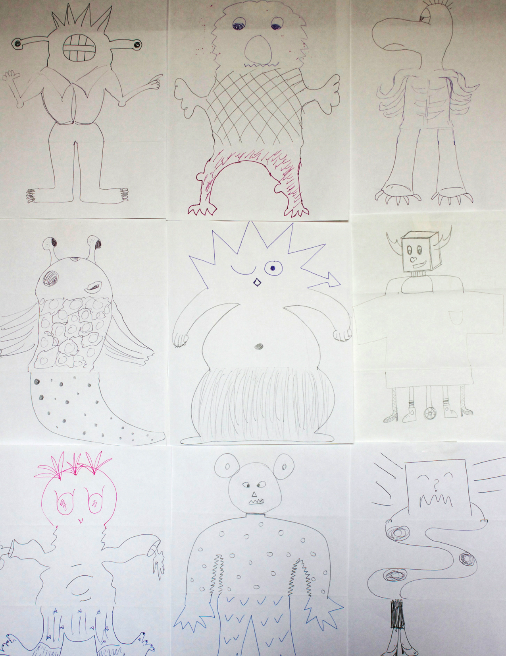
Notes:
<numéro>

Slide 14

PASS IT ON
OBJECTIVES
By completing this activity, students will:
be able to create a Scratch project that tells a story by reusing and remixing the work of others
experience pair programming by working in pairs to develop a collaborative storytelling project
UNIT 3 ACTIVITY
_{SUGGESTED TIME}
45–60 MINUTES
ACTIVITY DESCRIPTION
RESOURCES
Divide the group into pairs. Introduce students to the concept of a pass-it-on-story, a Scratch project that is started by a pair of people, and then passed on to two other pairs to extend and reimagine. Optionally, print out the Pass It On handout.
Encourage students to start in whatever way they want – focusing on characters, scene, plot, or whatever element excites them. Give each pair 10 minutes to work on their collaborative story before having them rotate to extend another story by remixing the project. Encourage students to give credit for reusing or remixing content.
After two rotations, allow students to revisit story projects with their contributions. We suggest hosting a Scratch screening: with projector and screen, present the story projects with students gathered around to watch. Optionally, invite students to add their projects to the Pass It On studio or a class studio.
Ask students to respond to the reflection prompts in their design journals or in a group discussion.
Pass It On handout
Pass It On studio http://scratch.mit.edu/studios/475543
Projector and screen to present student work (optional)
REFLECTION PROMPTS
How did it feel to remix and build on others’ work? How did it feel to be remixed?
Where else in your life have you seen or experienced reusing and remixing? Share two examples.
How was working with someone else different from your prior experiences of designing your Scratch projects?
REVIEWING STUDENT WORK
What parts of projects did students contribute to?
Do students seem comfortable with the concepts of events and parallelism and practices of reusing and remixing? If not, in what ways can these be further clarified?
NOTES
NOTES TO SELF
Consider organizing your Scratch screening as an event! Invite students from other classes to the viewing, offer snacks and drinks, or host the event in an auditorium or room with a large wall or screen for displaying projects.
Introduce students to the backpack (located at the bottom of the Scratch project editor) as another way to remix projects. Learn more about this tool in the Backpack video tutorial: http://bit.ly/scratchbackpack
68
Notes:
<numéro>

Slide 15
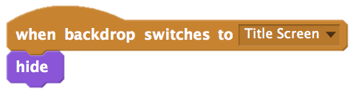
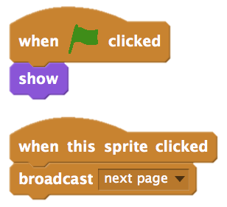
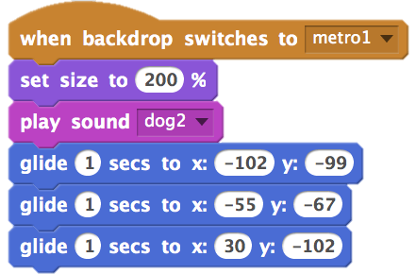
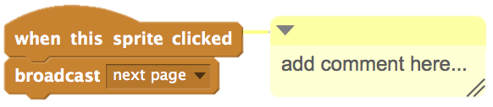
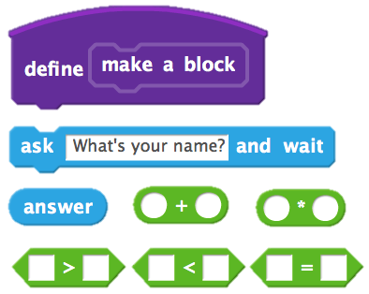
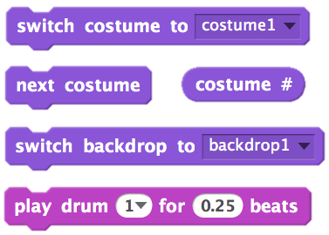

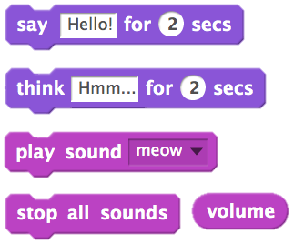
PASS IT ON
WHAT CAN WE CREATE BY BUILDING ON OTHERS’ WORK?
In this project, you will start developing an animated story project, and then you will pass the story on to others to remix, extend, or reimagine!
START HERE
Work on a story project that focuses on characters, scene, plot, or whatever element excites you.
After 10 minutes, save and share your project online.
Rotate & extend another story project by remixing it.
Repeat!
THINGS TO TRY
Brainstorm different possibilities for remixing, extending, or reimagining a story. Do you want to add a new scene to the end? Could you imagine what happens before the story begins? What if a new character was added? How about inserting a plot twist? What else?
Adding comments in your code can help others understand different parts of your program. To attach a comment to a script, right click on a block and add a description.
FINISHED?
BLOCKS TO PLAY WITH
FINISHED?
FINISHED?
Add your project to the Pass It On studio: http://scratch.mit.edu/studios/475543
Help a neighbor!
Return to all the projects you contributed to and check out how the stories evolved!
Notes:
<numéro>

Slide 16
70

